Slide 1

Competitive Programming Progress Hub: Overview
Introducing a platform to track, analyze, and improve programming skills.
Built with HTML, CSS, and JavaScript.
Designed to help programmers level up efficiently.
Group 11
Sant Kumar Singh(2201331720055)
Avnit Verma(22013331750024)
Ankit Kumar(2201331720012)

Slide 2

Core Functionality: Problem Submission
Problem Adding
Topic Categorization
Submit programming problems easily via an intuitive interface.
Organize problems by topics like Dynamic Programming or Graph Theory.
Problem statement input
Example: LeetCode 121. Best Time to Buy and Sell Stock
Source link or reference
Difficulty selection

Slide 3
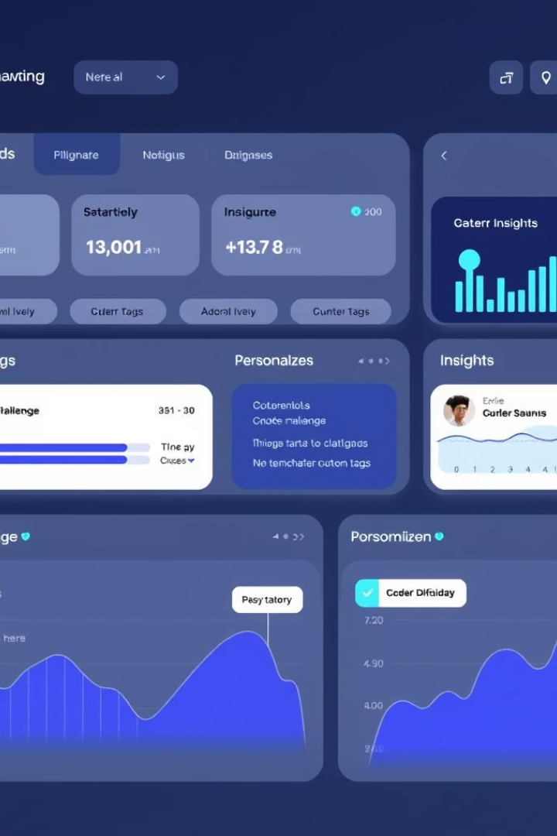
Difficulty Tracking & Tagging
Difficulty Levels
Custom Tags
Users assign Easy, Medium, or Hard labels to each problem.
Mark specific challenges like 'Time Limit Exceeded' or 'Segmentation Fault.'
Personalized Insight
Analyze which difficulties are most common for each user.

Slide 4



Performance Metrics: Visualizing Progress
Time Taken
2
Analyze time invested per problem and improvements.
Problems Solved
1
Track total solved problems over time.
Attempts
Understand trial counts to identify tough problems.
3

Slide 5

Technology Stack: HTML, CSS, JavaScript
Responsive Front-end
Built with HTML5 and CSS3 for smooth design.
Interactive Features
JavaScript powers dynamic content and user interaction.
Data Visualization
Chart.js or similar libraries to graph performance data.
Accessibility
Ensures cross-browser compatibility and mobile use.

Slide 6
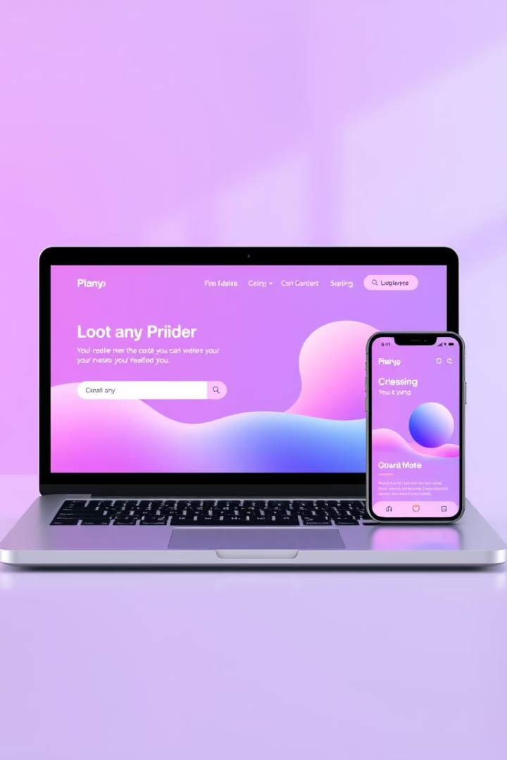
User Interface (UI) and User Experience (UX)
Intuitive Navigation
Easy to explore for programmers of all skill levels.
Continuous Feedback
User suggestions drive ongoing improvements.

Slide 7




Benefits: Targeted Skill Development
Identify Gaps
Focused Efforts
Track Progress
Pinpoint areas needing further practice easily.
Target weak topics to improve efficiently.
Stay motivated by watching steady skill growth.

Slide 8
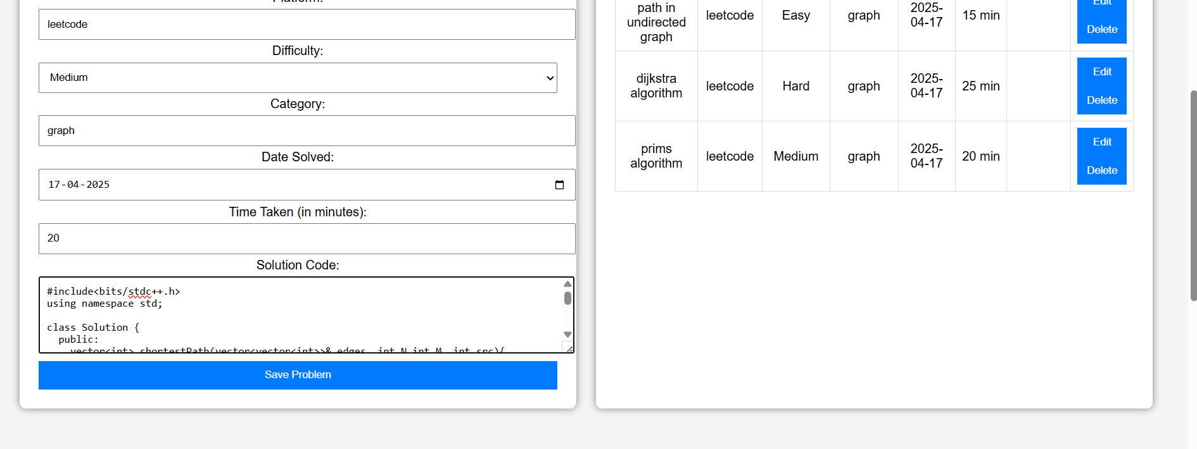
Screenshots

Slide 9
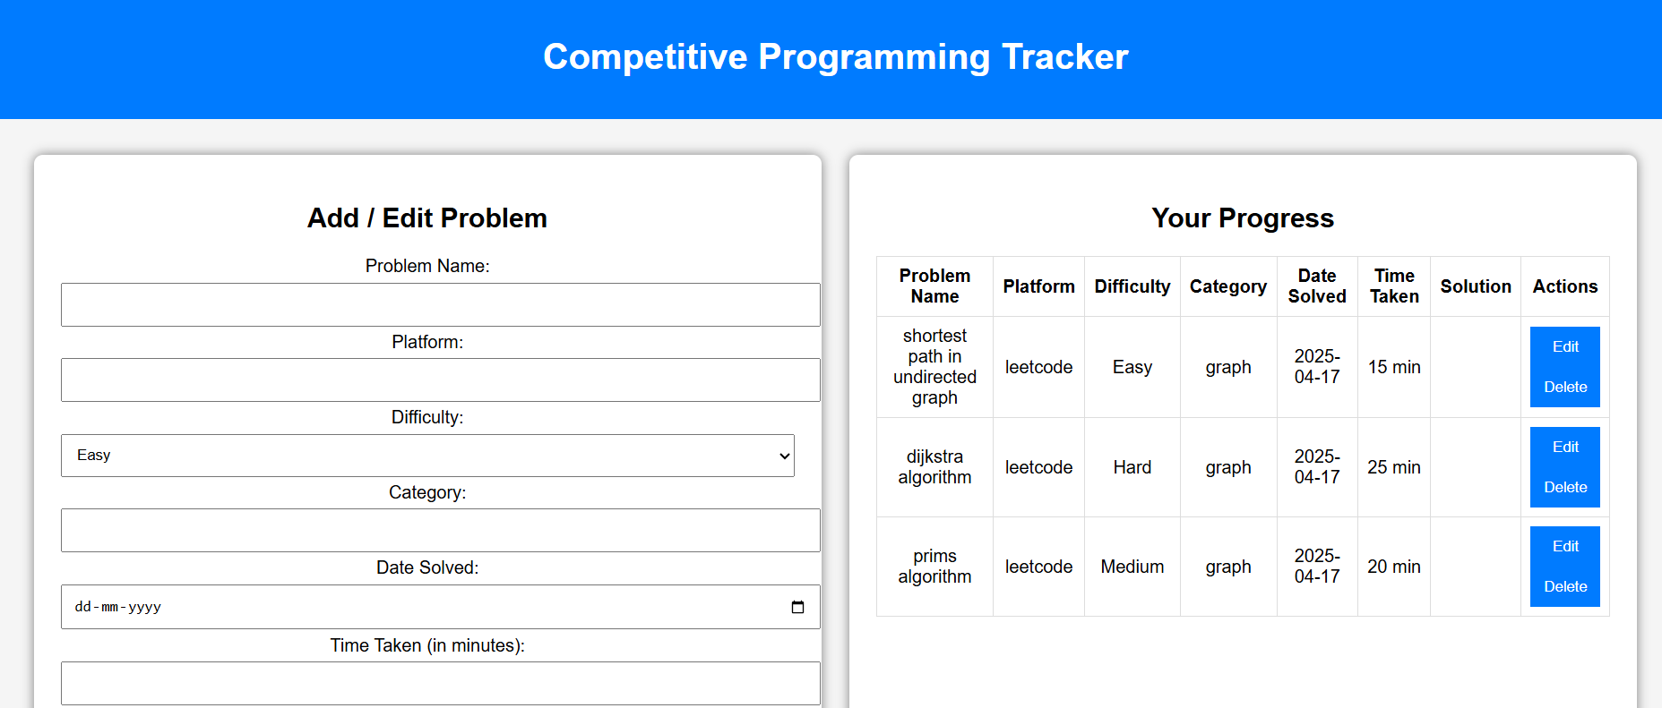

Slide 10
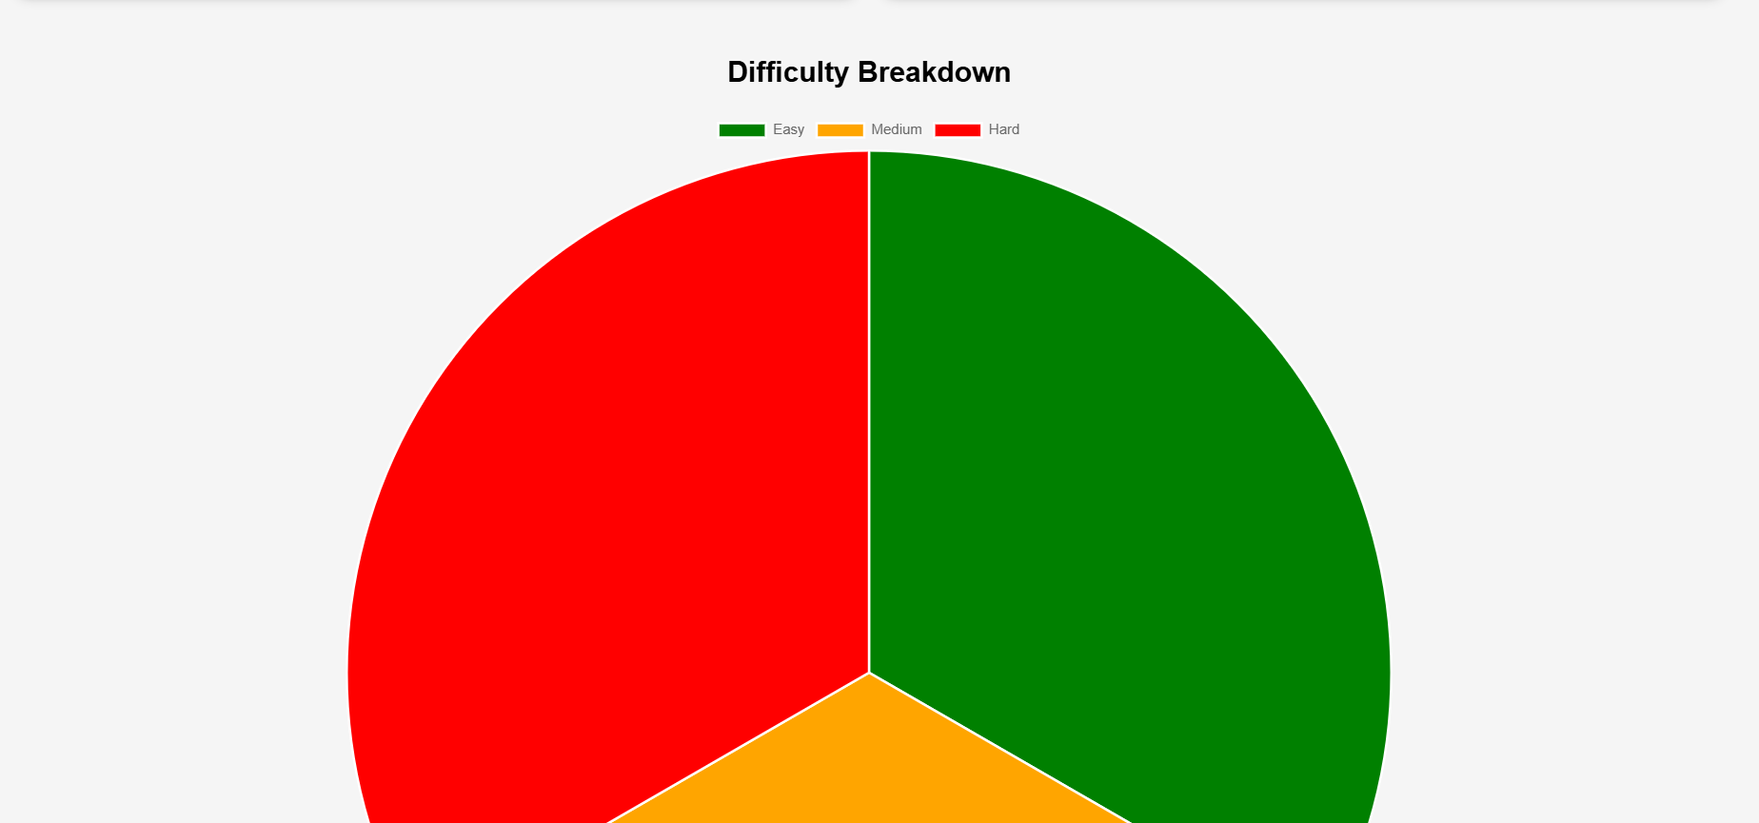

Slide 11

Future Enhancements: Collaboration & Community
Study Groups
Discussion Forums
Collaborate on problems and share insights.
Share solutions, tips, and ask questions.
Leaderboards
Platform Integration
Encourage friendly competition and motivation.
Connect with popular competitive programming sites.
Security in the Progress Hub
Ensuring user data safety is our top priority.
We implement strong authentication and encryption methods.
Data Encryption
User Authentication
All sensitive data is securely encrypted in transit and at rest.
Multi-factor authentication ensures authorized access only.
Regular Audits
Privacy Compliance
Frequent security assessments prevent vulnerabilities and threats.
Adherence to industry standards like GDPR protects user privacy.

Slide 12

Demonstration: Live Walkthrough
Feature Showcase
Explore problem addition and topic tagging.
Progress Tracking
See live visualizations of performance data.
User Benefits
Experience how the platform accelerates skill growth.
Q&A
Answer participant questions and gather feedback.

Slide 13
Conclusion: Empowering Competitive Programmers
The Progress Hub empowers personalized learning and tracking.
Thank you for exploring this journey to master competitive programming.
It targets skill gaps for efficient improvement.
We invite you to join and grow with the community.
Open to user feedback and future enhancements.

Slide 14
Thank You
We appreciate your time and interest in the Progress Hub.
Join us to enhance your competitive programming skills and community engagement.
1
Stay Connected
2
Get Involved
3
Keep Improving
Follow updates and future platform enhancements.
Participate in study groups and challenges.
Track your progress and sharpen your skills continuously.

